Slide 1
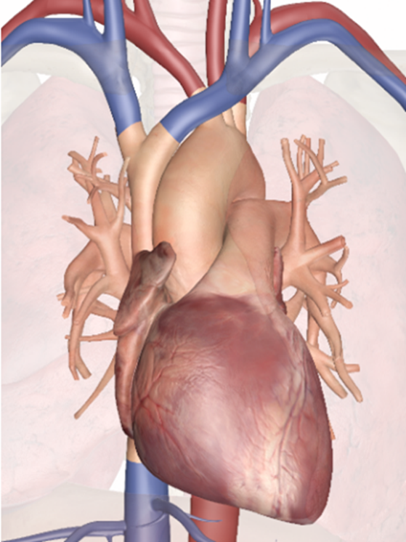
Function of the heart
Structure
Heart as a pump
Electrical behaviour of cardiac cells
Ventricular activation
This presentation contains an overview of the topics you need to know. The detailed explanations behind this are presented in video fragments which are available on your USB stick.
18.1.1 The function of the heart
Unit C 18.1 Maintaining cardiovascular and monitoring equipment
Module 279 19 C Medical Instrumentation II
©
dr. Chris R. Mol, BME, NORTEC, 2017

Slide 2
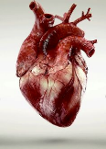
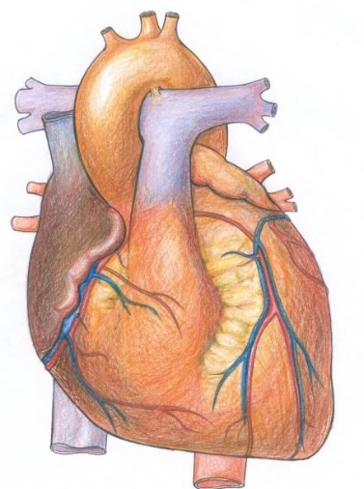
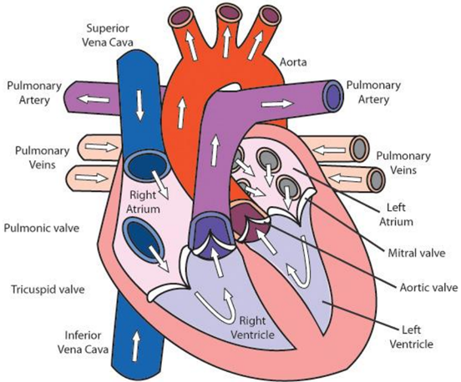
Anatomic structure of the heart
coronary arteries and veins
©
Cardiology
dr. Chris R. Mol, BME, NORTEC, 2017

Slide 3
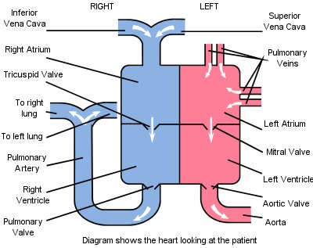
Functional diagram of the pumping heart
©
Cardiology
dr. Chris R. Mol, BME, NORTEC, 2017

Slide 4
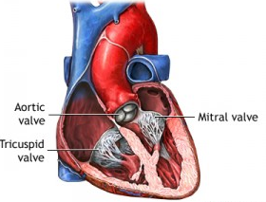
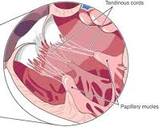
Heart Valves
heart valves prevent blood flow in the wrong (‘backwards’) direction
Tendinous cords
Papillary muscles
©
Cardiology
dr. Chris R. Mol, BME, NORTEC, 2017

Slide 5
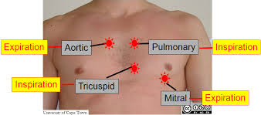
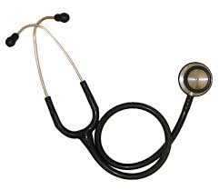
Heart Valves and Sounds
Diagnosis of heart valve function through ‘auscultation’
©
Cardiology
dr. Chris R. Mol, BME, NORTEC, 2017

Slide 6
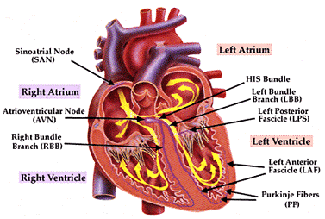
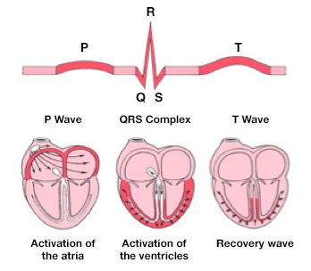
Cardiac Conduction System and ECG
©
Cardiology
dr. Chris R. Mol, BME, NORTEC, 2017

Slide 7
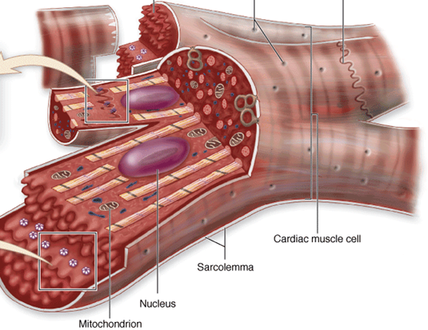
Cardiac cells: activation and contraction
There are two types of cells within the heart:
cardiomyocytes (heart muscle cells) make up the atria and the ventricles. These cells must be able to shorten and lengthen their fibres and the fibres must be flexible enough to stretch.
cardiac pacemaker cells carry the electrical impulses that are responsible for the beating of the heart. They are distributed throughout the heart and are responsible for several functions. First, they are responsible for being able to spontaneously generate and send out electrical impulses. They also must be able to receive and respond to electrical impulses from the brain. Lastly, they must be able to transfer electrical impulses from cell to cell.
cardiomyocyte
All of these cells are connected by cellular bridges. Porous junctions called intercalated discs form junctions between the cells. They permit sodium, potassium and calcium to easily diffuse from cell to cell. This makes it easier for depolarization and repolarization in the myocardium. Because of these junctions and bridges the heart muscle is able to act as a single coordinated unit.
intercalated discs
©
Cardiology
dr. Chris R. Mol, BME, NORTEC, 2017

Slide 8
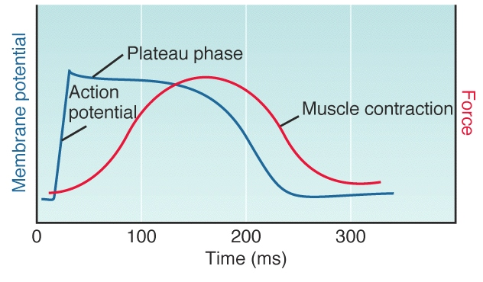
Cardiac cells: activation and contraction
©
Cardiology
dr. Chris R. Mol, BME, NORTEC, 2017

Slide 9
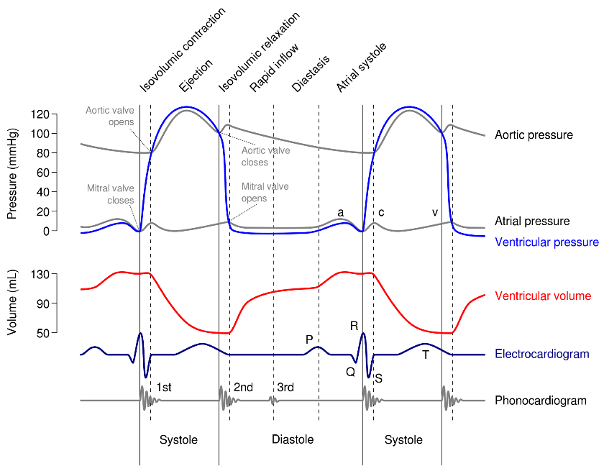
Heart function: overview
©
Cardiology
dr. Chris R. Mol, BME, NORTEC, 2015

Slide 10
END
The creation of this presentation was supported by a grant from THET:
see https://www.thet.org/

